Slide 1
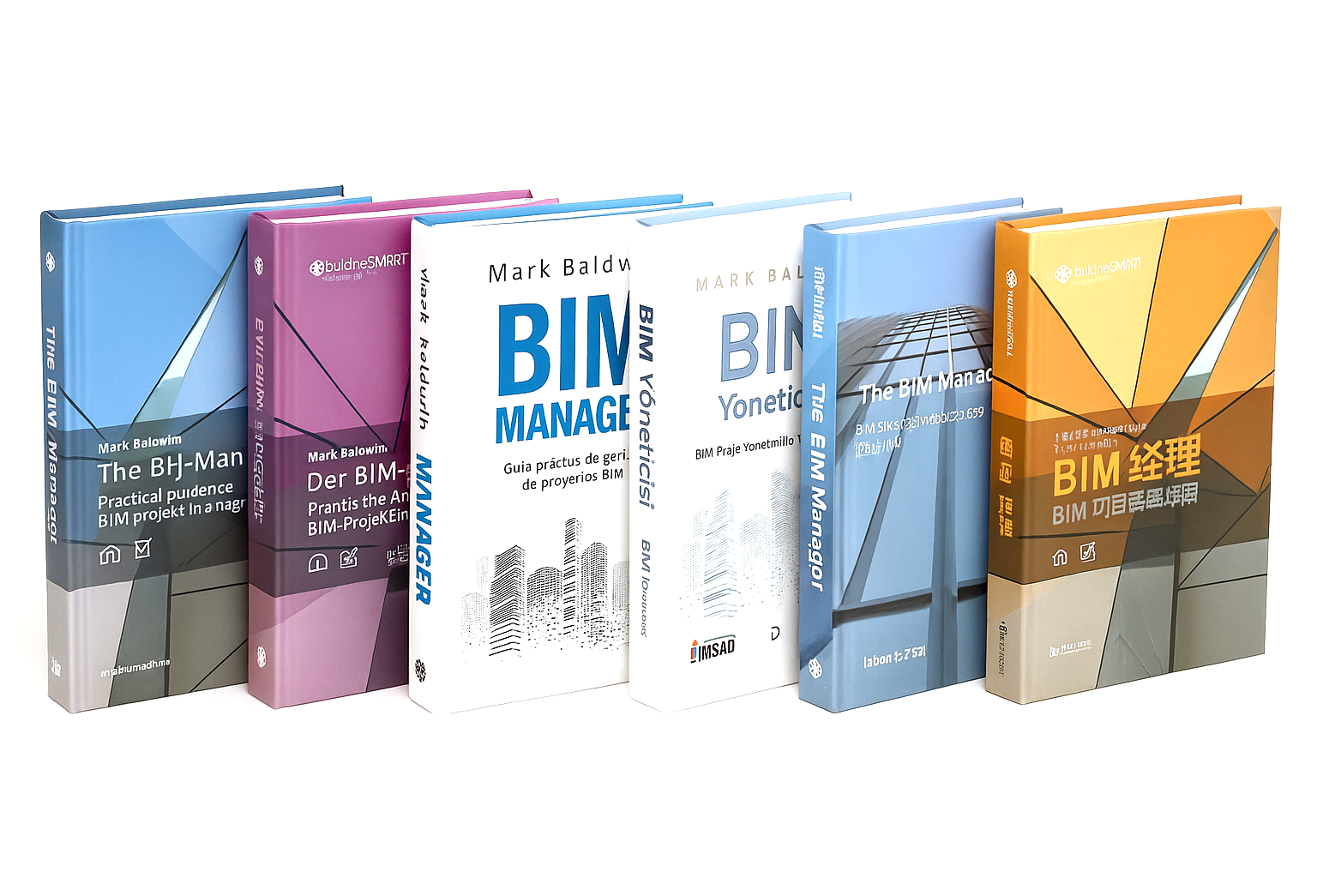

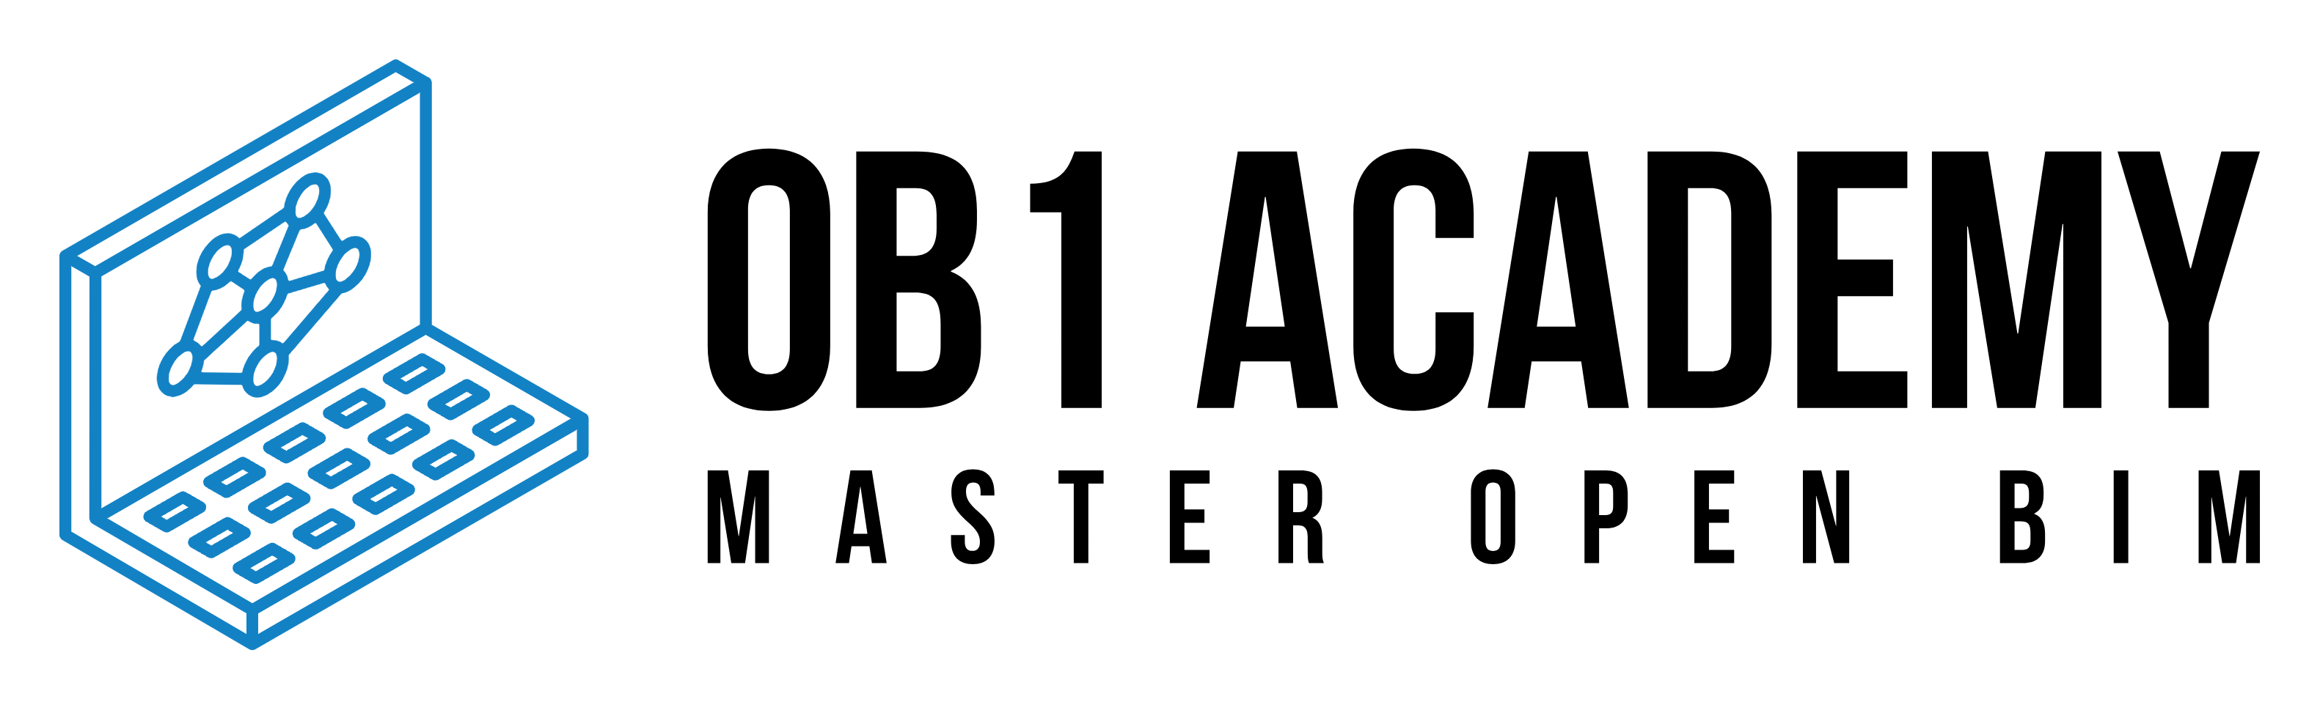

future skills _ in the era of digitalisation and ai
Prof. Mark Baldwin
Professor | Architect | Author | BIM Expert
european council
on computing in
construction (ec3)

Slide 2


future skills _ in the era of digitalisation and ai
_ global trends
_ our industry
_ education
_future skills

Slide 3
main sectors of employment
_lessons from the past
_ global trends
_ our industry
_ education
_future skills
1800
2000
2050
?
percentage of US private sector employees by sector, 1800–2000
source: Federal Reserve Bank of Dallas
own assumption
(mark baldwin)

Slide 4
sectors to be disrupted by ai
_deloitte report
_ global trends
_ our industry
_ education
_future skills
reduced employment in
clerical and administrative roles
Technology & Software: Programmers, ICT sales professionals, database administrators, and ICT trainers.
Business, Finance & HR: Accountants, HR managers, and law clerks.
Administration & Sales: Secretaries, telemarketers, and logistics workers.
Creative & Specialized Services: Graphic designers and librarians.
increased employment in
roles with strong human elements
CEOs and Managers
Psychologists and Carers
Teachers
Legislators and Life Scientists
deloitte access economics employment forecasts
source: deloitte, june 2026

Slide 5
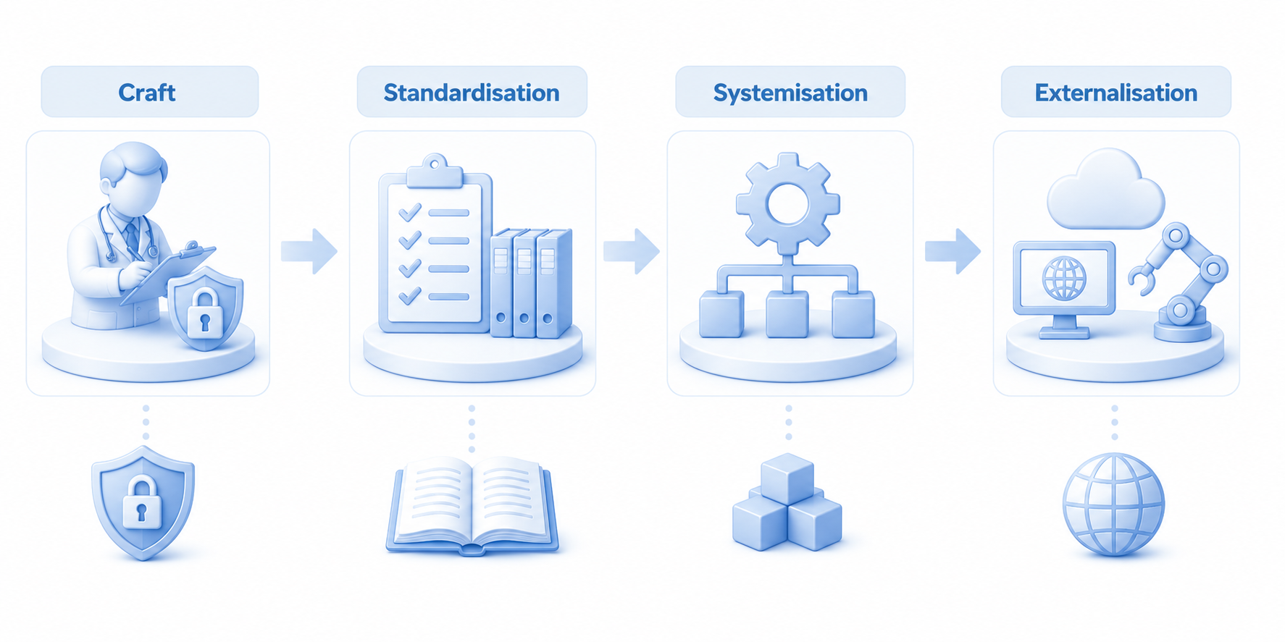
the future of the professions
_according to r and d susskind
_ global trends
_ our industry
_ education
_future skills
sacred knowledge
human creativity
standards
and regulation
measure
and calculation
digitalisation
and automation
Notes:
Historically, professions were seen as crafts or guilds, where knowledge was sacred and only available to a few revered specialists.
Over time, it became clear that knowledge could be standardised and regulated.
Through standardisation, we created systems to help us measure and calculate.
With the advent of the internet, knowledge became externalised and freely available outside of the profession.
Through digitalisation and AI, this knowledge has become even more accessible. Many tasks that were considered professional skills became automated.
Example:
Craft: design of indoor environmental quality
Standardisation: Performance requirements (e.g. building regulations)
Systemisation: Breakdown of object properties / definition (e.g. U-value)
Digitalisation/Automation: Model-based simulation

Slide 6


digital transformers
_most impactfull technologies
_ global trends
_ our industry
_ education
_future skills
robotics
artificial intelligence
Notes:
_technologies that will have the greatest impact on our society in the future
Two of the most impactfulö mega trands are robotics and AI
Combined, these technologies are going to radically transform our world - and not least the construction sector!

Slide 7
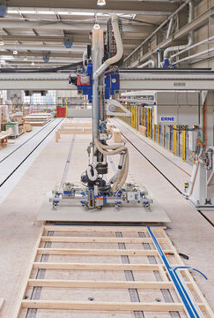
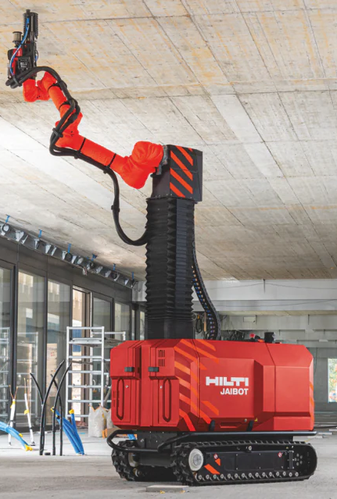
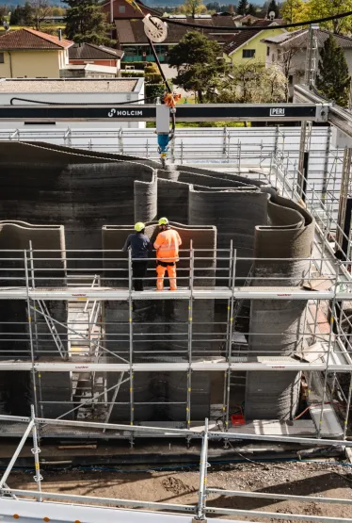
robotics in construction
_ global trends
_ our industry
_ education
_future skills
_prefabrication
(source: erne)
_construction robots
(source: hilti)
_3d printing
(source: holcim lafarge)

Slide 8
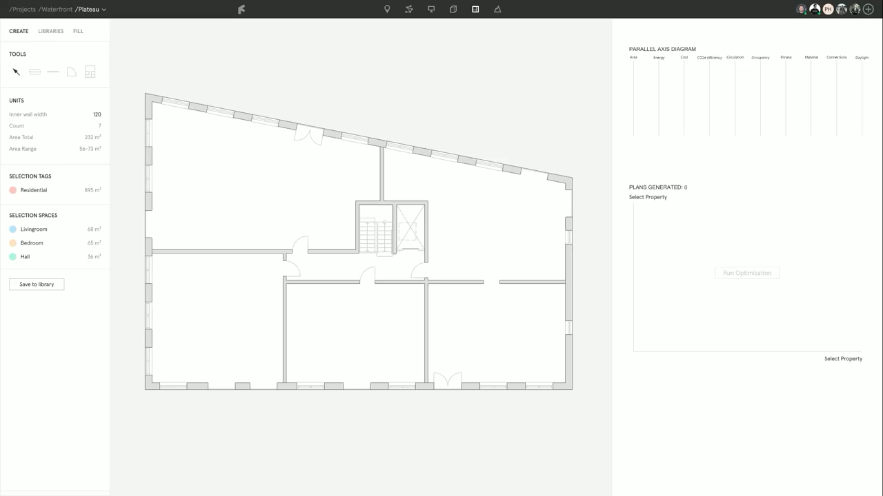
ai in design
_ global trends
_ our industry
_ education
_future skills
source: finch 3d

Slide 9
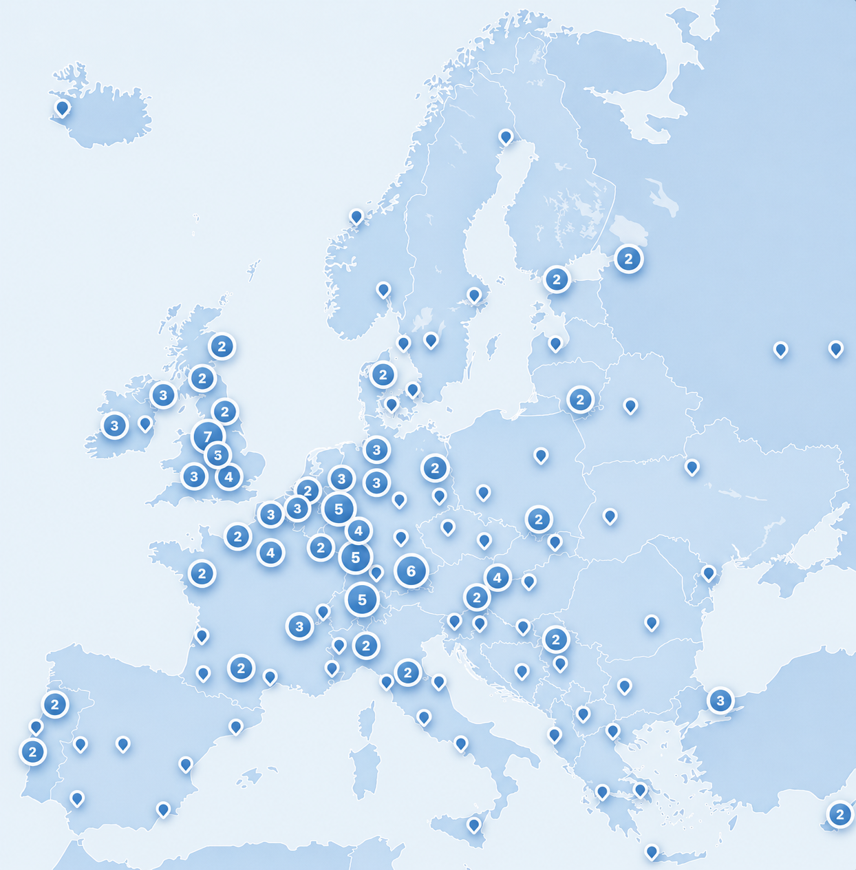
digital construction education in europe
_study from the european council on computing in construction (ec3)
_ global trends
_ our industry
_ education
_future skills
_35 countries
_187 institutions
_13,900 graduates per year
_top 3 regions
Region | Countries | No. of Institutions
DACH | Germany, Austria, Switzerland | 46
British Isles | UK, Ireland | 29
Iberia | Spain, Portugal | 25
macro analysis of computing in construction education in europe
P. Martinez, M. Baldwin, N. Bartels, K. Blay, S. Esser, T. Maile,
June 2026
Notes:
This study presents the first comprehensive mapping of construction computing education in Europe, analysing 187 validated institutions across 35 countries.

Slide 10
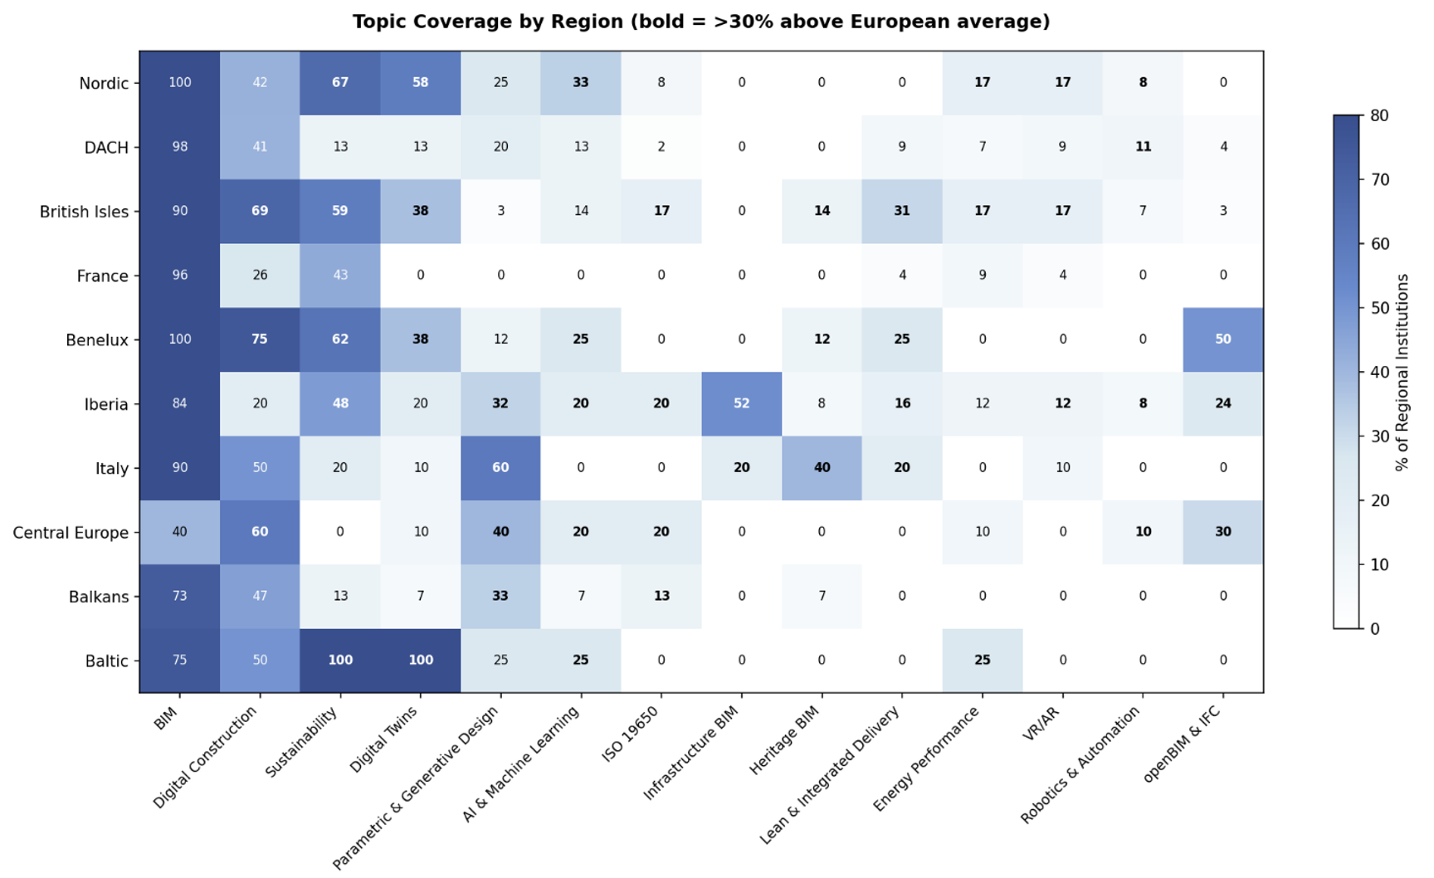
digital construction education in europe
_study from the european council on computing in construction (ec3)
_heatmap of the topic coverage in academic programs across European regions
_ global trends
_ our industry
_ education
_future skills
_leading topic areas
_bim
_digital construction
_sustainability
_digital twins
_parametric design
_ai & ml
_iso 19650
macro analysis of computing in construction education in europe
P. Martinez, M. Baldwin, N. Bartels, K. Blay, S. Esser, T. Maile,
June 2026

Slide 11
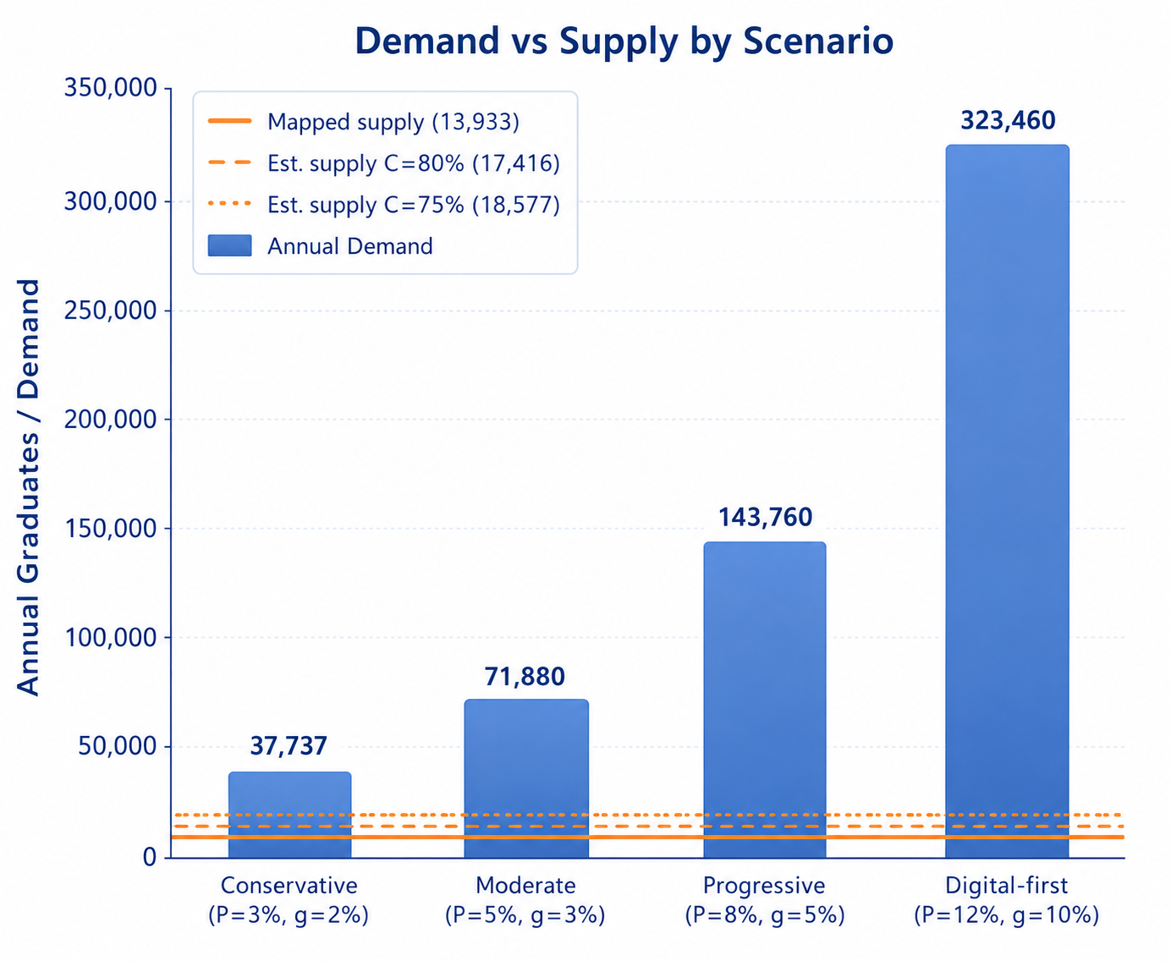
digital construction education in europe
_study from the european council on computing in construction (ec3)
_demand vs supply by scenario
_ global trends
_ our industry
_ education
_future skills
_35 countries
_187 institutions
_13,900 graduates per year
> 10%
> 20%
macro analysis of computing in construction education in europe
P. Martinez, M. Baldwin, N. Bartels, K. Blay, S. Esser, T. Maile,
June 2026

Slide 12
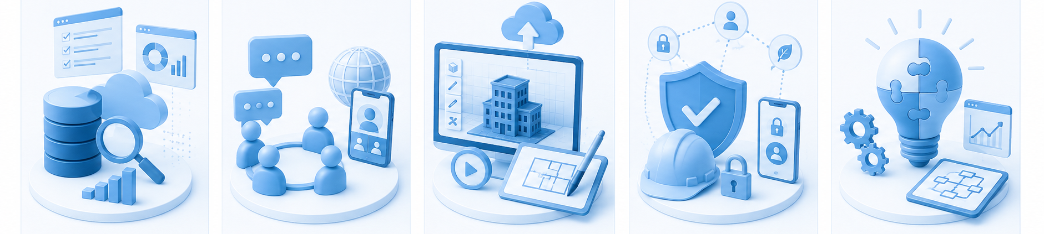
digital competence
_ global trends
_ our industry
_ education
_future skills
information
& data literacy
communication
& collaboration
digital
content creation
safety
& security
problem
solving
find, evaluate, organise, and manage digital information and data effectively
communicate, collaborate, and participate responsibly through digital technologies.
create, adapt, and share digital content while respecting intellectual property and using computational thinking.
protect devices, data, well-being, and the environment when using digital technologies.
use digital technologies to solve problems, innovate, and continuously adapt to change.
the digital competence framework for citzens
source: european comission, 2022

Slide 13

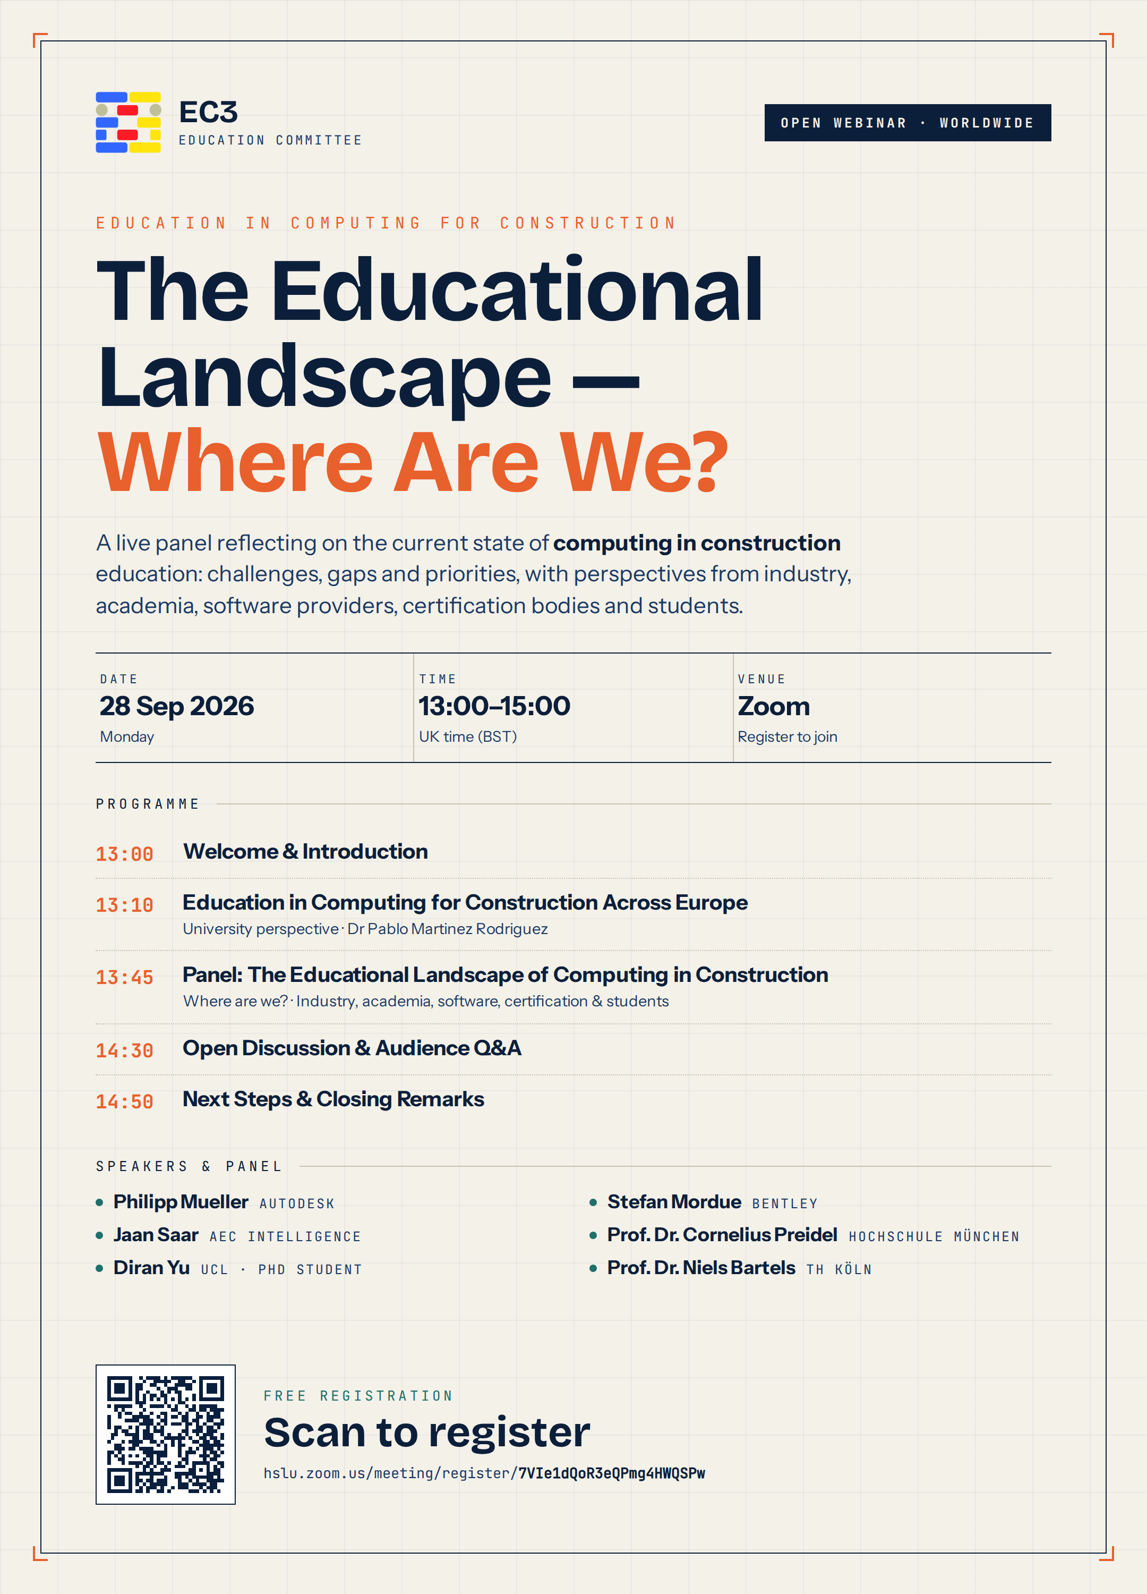
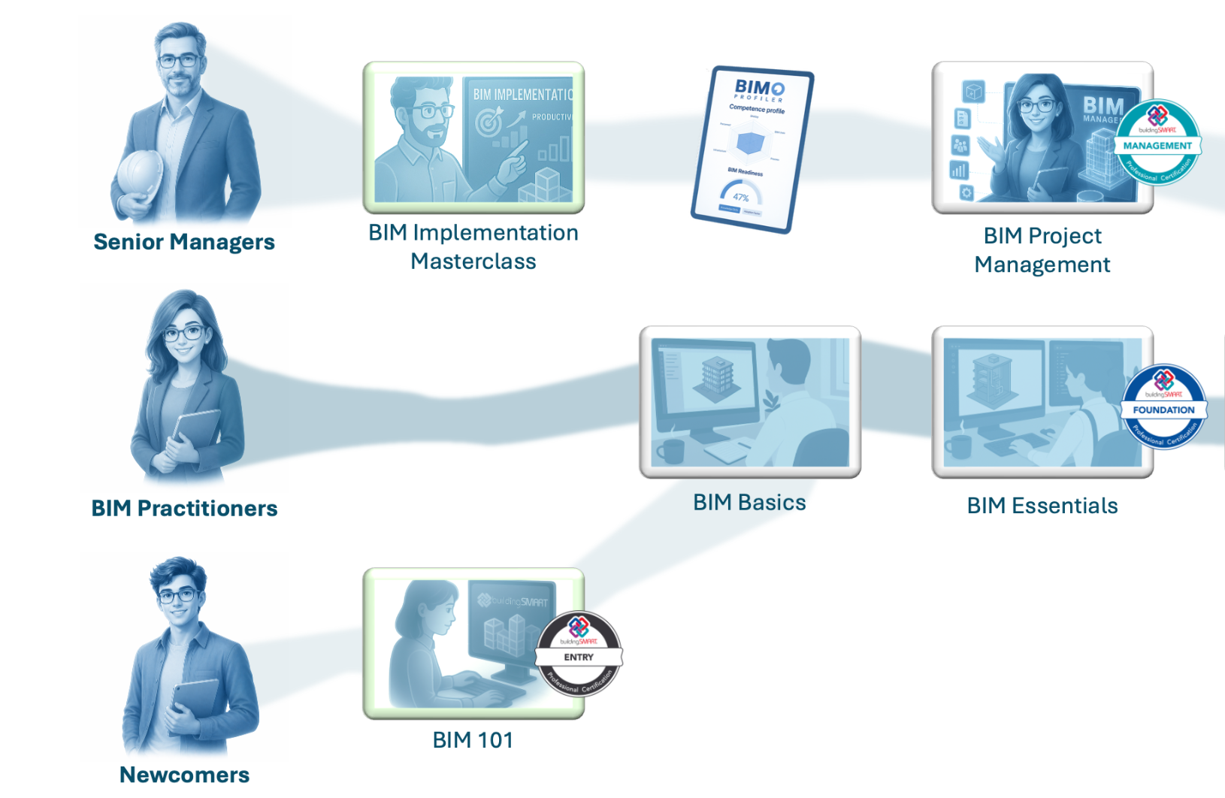

_resources
_free ec3 online event
_free online courses
_the bim manager
portuguese edition
www.ob1.academy

